Slide 1
PROSPECTING The Way of the Future Ken Wolf – Director of Training - Sales

Slide 2
Take A Trip with Me

Slide 3
INTO THE FUTURE

Slide 4
Three Steps to Success
SUCCESS
Ask for
The Order
Build
Relation
Prospect

Slide 5
Available Acres / Year…….

Slide 6
Setting Goals
So with only 21% of the acres
available it is important that you get
on as many as possible.
What is your GOAL?
20 new customer
$100,000 commissions

Slide 7
Goals …. Getting There
Average size sale?
How many Hybrids and Varieties?
What is your closing rate?
ALL OF THESE FACTORS WILL
DETERMINE THE NUMBER OF
NEW CUSTOMERS YOU WILL
NEED.

Slide 8
Number of NEW Customers Needed
30 Prospects Needed
Available in 21% of the field
30 / .21 = 143 contacts needed to
be made over the recruiting time.
143 / 12 weeks = 12 calls per week

Slide 9
Goals…. Getting There
WHAT
ARE
YOUR
NUMBERS?

Slide 10
Review
Set your goal
Figure out how many new customers
Figure out how many calls
1st Call 10 -15 minutes
Make lots of 1st calls
See the people
Use your tools

Slide 11
QUESTIONS?

Slide 12
Thank You !

Slide 13
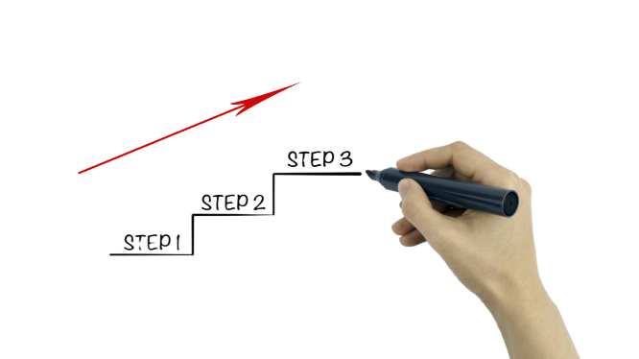
Three Steps to Success For Every ISR
Ask for
The Order
Build
Relation
Prospect

Slide 14
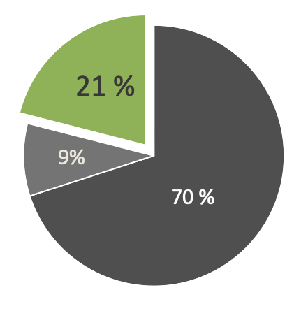
Know Your Market
21% Will Buy – 79% Won’t
Numbers represent % of available acres

Slide 15
Know Your Goal
30
$100K
New Customers
Commission

Slide 16
Know Your Numbers
30 Prospects Needed
Available in 21% of the field
30 / .21 = 143 contacts needed to
be made over the recruiting time.
143 / 12 weeks = 12 calls per week

Slide 17
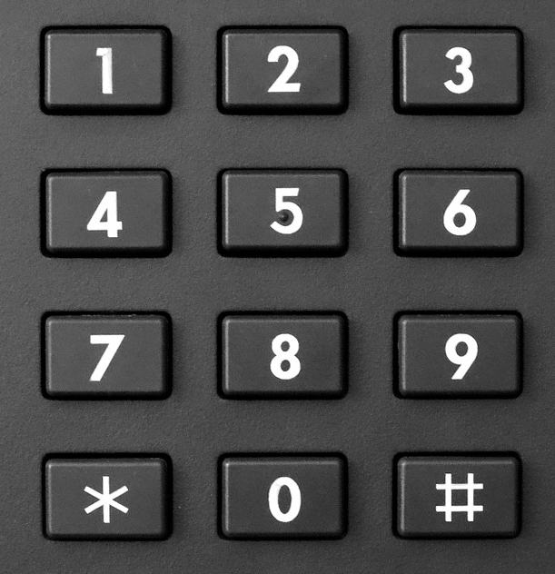
Remember, Always Know…
Your Market
Your Goal
Your Numbers

